Slide 1



Databases, MySQL & PHP
Managing data

Slide 2

Building Data Dynamic Web Sites
Truly dynamic web sites
Content changes over time
Content customised for individual user
Content automatically generated
Content Programmatically generated
Can be File system based
HTML and Images stored on File System
Gets hard to manage over time
Database based
HTML, Images etc all generated from database
Easier to manage
If data is too large, can overload the database

Slide 3


Database?

Slide 4

Database
Structured collection of data.
Tables
Fields
Query
Reports
Essentially a much more sophisticated implementation of the flat files.

Slide 5


Relational Database

Slide 6
Relational Database
Stores data in separate tables instead of a single store.
Relationships between tables are set
In theory, this provides a faster, more flexible database system.

Slide 7

Example
We wish to maintain a database of student names, IDs, addresses, and any other information.
Will be updated frequently with new names and information.
Will want to retrieve data based on some predicate.
e.g, ‘give me the names of all Massey students who live in Albany’.
Will want to update database with new information about students, not previously recorded.
e.g., may decide we want to include IRD nos.
Very difficult to manage using ‘flat file’ systems

Slide 8

Databases
Fast, Efficient back end storage
Easier to manage than file system based approach
Relational Database structure
Well developed theory and practise
Multi-user capable
Multithreaded, multiprocessor, sometimes cluster based systems
Standards based queries
– Structured Query Language (SQL)

Slide 9

MySQL Database
world's most popular open source database because of its consistent fast performance, high reliability and ease of use
Open Source License:- free
GNU General Public License
Free to modify and distribute but all modification must be available in source code format
Commercial:- not free
Fully paid up professional support
used by Google, Facebook Nokia, YouTube, Yahoo!, Alcatel-Lucent, Zappos.com, etc.

Slide 10

Basic Database Server Concepts
Database runs as a server
Attaches to either a default port or an administrator specified port
Clients connect to database
For secure systems
authenticated connections
usernames and passwords
Clients make queries on the database
Retrieve content
Insert content
SQL (Structured Query Language) is the language used to insert and retrieve content

Slide 11


Database Management System?

Slide 12
Database Management System
Manages the storage and retrieval of data to and from the database and hides the complexity of what is actually going on from the user.
Database Management Ssytem
Database
User
MySQL is a relational database management system

Slide 13





Client: makes a request
requests an Internet
Client (browser)
resource by specifying a URL and
providing input via HTTP
encoded strings
Web browser
GET hello.php HTTP/1.1 Host: www.massey.ac.nz:80
Server
os
Web server
os
Internet
Network Core

Slide 14




Server: responds
Webserver supports HTTP.
Server
Web server
My codes
MySQL
PHP
interpreter
HTTP
HTML
Client
Operating System
Web browser
TCP/IP
Internet

Slide 15



Server: responds
Internet
MySQL
Operating System
Server
MySQL server could be anywhere in the world
Web server
My codes
PHP
interpreter
HTTP
HTML
Client
Operating System
Web browser
TCP/IP
Internet

Slide 16


phpMyAdmin
MySQL can be controlled through a simple command-line interface; however, we can use phpMyAdmin as an interface to MySQL.
phpMyAdmin is a very powerful tool; it provides a large number of facilities for customising a database management system.

Slide 17


Server: responds
Webserver supports HTTP.
Server
Web server
My codes
phpMyA
dmin
MySQL
PHP
interpreter
HTTP
HTML
Client
Operating System
Web browser
TCP/IP
Internet

Slide 18


Database Example
A Quick Tour

Slide 19
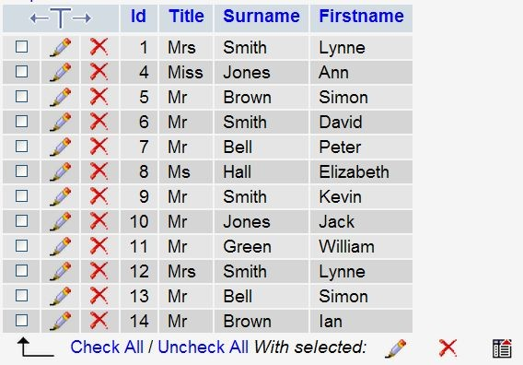
Table: Customers (data)

Slide 20
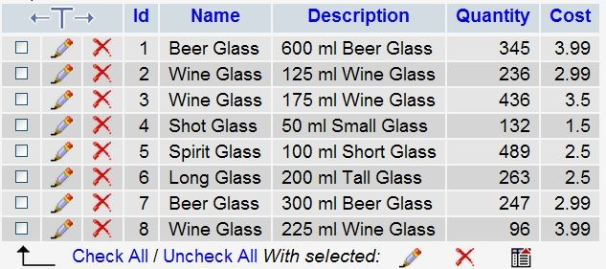
Table: Products (data)

Slide 21
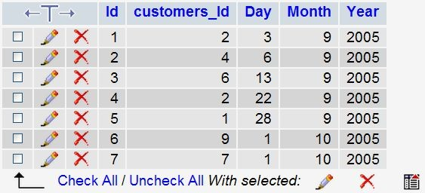
Table: Purchases (data)

Slide 22
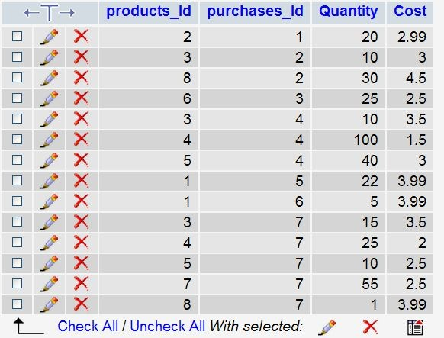
Table: PurchaseProducts (data)

Slide 23
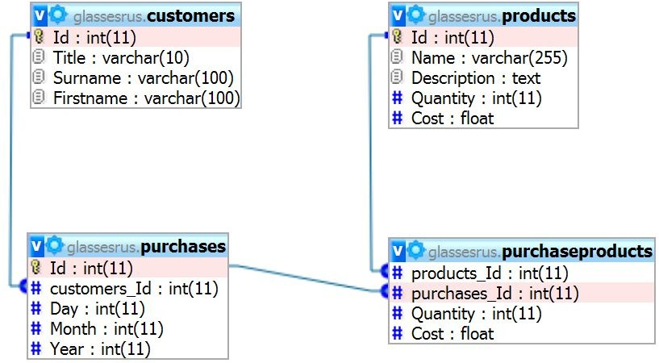
Database Design

Slide 24


Database Field Types
In MySQL there are three main types :
text
number
Date/Time.

Slide 25

Text Field Types
CHAR(size) | Holds a fixed length string (can contain letters, numbers, and special characters). The fixed size is specified in parenthesis. Can store up to 255 characters
VARCHAR(size) | Holds a variable length string (can contain letters, numbers, and special characters). The maximum size is specified in parenthesis. Can store up to 255 characters. Note: If you put a greater value than 255 it will be converted to a TEXT type
TINYTEXT | Holds a string with a maximum length of 255 characters
TEXT | Holds a string with a maximum length of 65,535 characters
MEDIUMTEXT | Holds a string with a maximum length of 16,777,215 characters
LONGTEXT | Holds a string with a maximum length of 4,294,967,295 characters
ENUM(x,y,z,etc.) | Let you enter a list of possible values. You can list up to 65535 values in an ENUM list. If a value is inserted that is not in the list, a blank value will be inserted.Note: The values are sorted in the order you enter them. You enter the possible values in this format: ENUM('X','Y','Z')
http://www.w3schools.com/sql/sql_datatypes.asp

Slide 26
Numeric Field Types
TINYINT(size) | -128 to 127 normal. 0 to 255 UNSIGNED*. The maximum number of digits may be specified in parenthesis
SMALLINT(size) | -32768 to 32767 normal. 0 to 65535 UNSIGNED*. The maximum number of digits may be specified in parenthesis
MEDIUMINT(size) | -8388608 to 8388607 normal. 0 to 16777215 UNSIGNED*. The maximum number of digits may be specified in parenthesis
INT(size) | -2147483648 to 2147483647 normal. 0 to 4294967295 UNSIGNED*. The maximum number of digits may be specified in parenthesis
BIGINT(size) | -9223372036854775808 to 9223372036854775807 normal. 0 to 18446744073709551615 UNSIGNED*. The maximum number of digits may be specified in parenthesis
FLOAT(size,d) | A small number with a floating decimal point. The maximum number of digits may be specified in the size parameter. The maximum number of digits to the right of the decimal point is specified in the d parameter
DOUBLE(size,d) | A large number with a floating decimal point. The maximum number of digits may be specified in the size parameter. The maximum number of digits to the right of the decimal point is specified in the d parameter
DECIMAL(size,d) | A DOUBLE stored as a string , allowing for a fixed decimal point. The maximum number of digits may be specified in the size parameter. The maximum number of digits to the right of the decimal point is specified in the d parameter
http://www.w3schools.com/sql/sql_datatypes.asp

Slide 27
Date and Time Field Types
DATE() | A date. Format: YYYY-MM-DDNote: The supported range is from '1000-01-01' to '9999-12-31'
DATETIME() | *A date and time combination. Format: YYYY-MM-DD HH:MM:SSNote: The supported range is from '1000-01-01 00:00:00' to '9999-12-31 23:59:59'
TIMESTAMP() | *A timestamp. TIMESTAMP values are stored as the number of seconds since the Unix epoch ('1970-01-01 00:00:00' UTC). Format: YYYY-MM-DD HH:MM:SSNote: The supported range is from '1970-01-01 00:00:01' UTC to '2038-01-09 03:14:07' UTC
TIME() | A time. Format: HH:MM:SSNote: The supported range is from '-838:59:59' to '838:59:59'
YEAR() | A year in two-digit or four-digit format.Note: Values allowed in four-digit format: 1901 to 2155. Values allowed in two-digit format: 70 to 69, representing years from 1970 to 2069
http://www.w3schools.com/sql/sql_datatypes.asp

Slide 28
phpMyAdmin
A Quick Tour

Slide 29

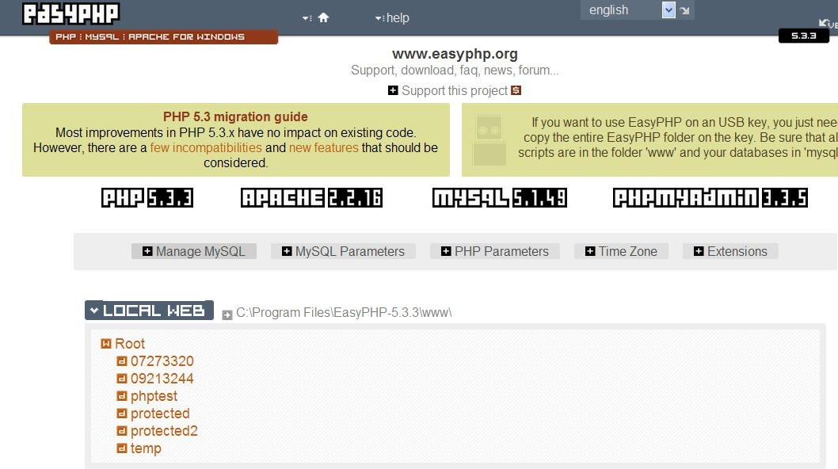

phpMyAdmin

Slide 30
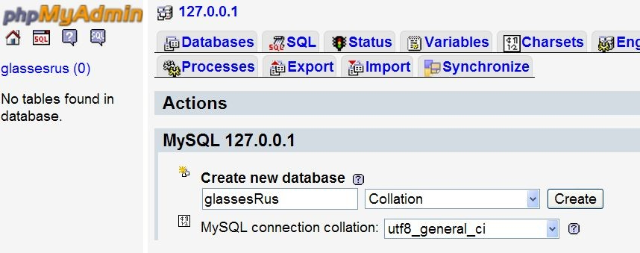
Create Database

Slide 31
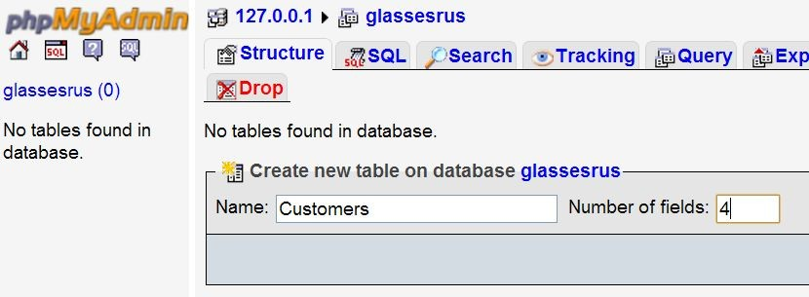
Create Table: Customers

Slide 32
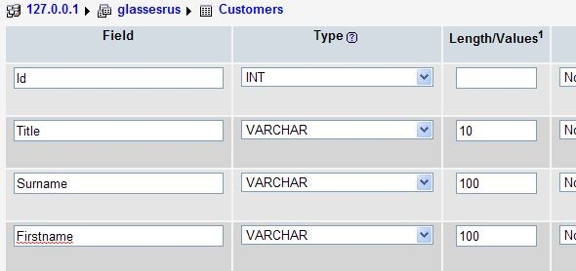
Specify the Table’s Fields & Attributes: Customers

Slide 33
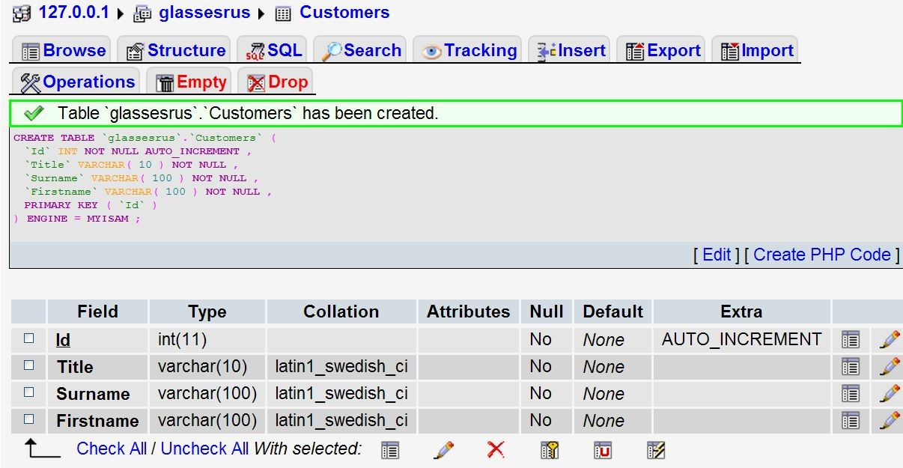
Table Edit Screen: Customers

Slide 34
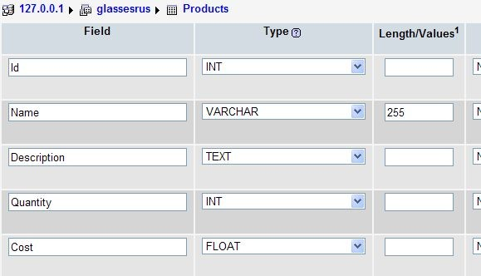
Table: Products

Slide 35
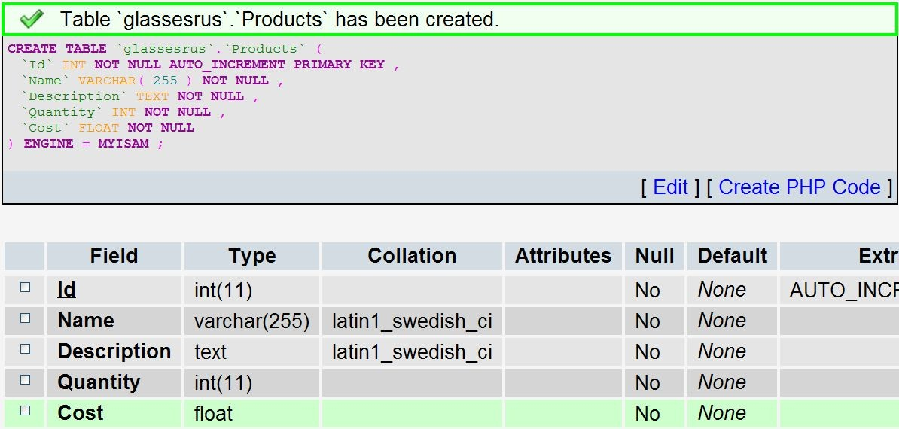
Table: Products

Slide 36
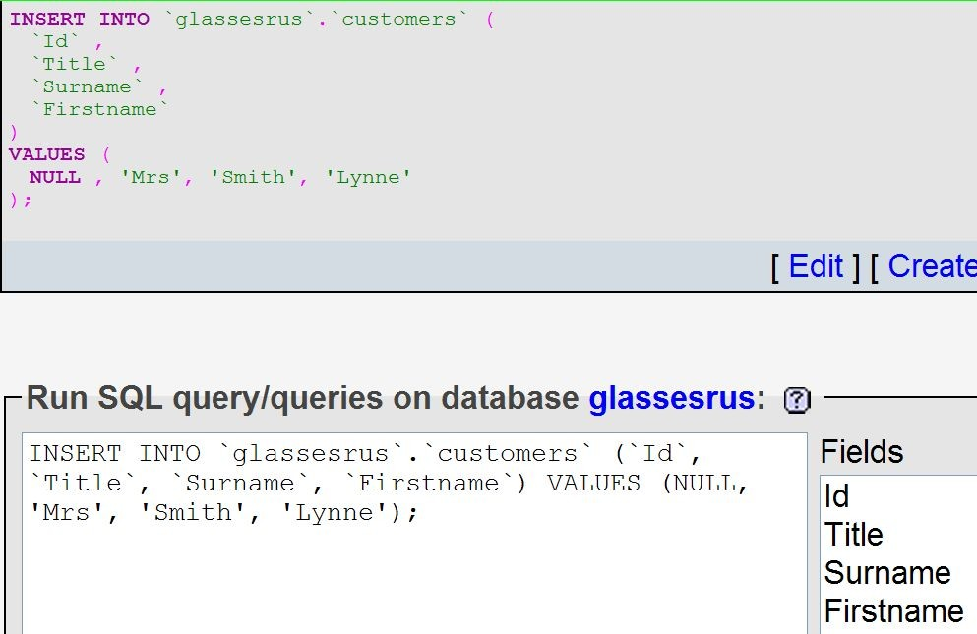
Insert Record: Customers

Slide 37
Table: Customers (data)

Slide 38
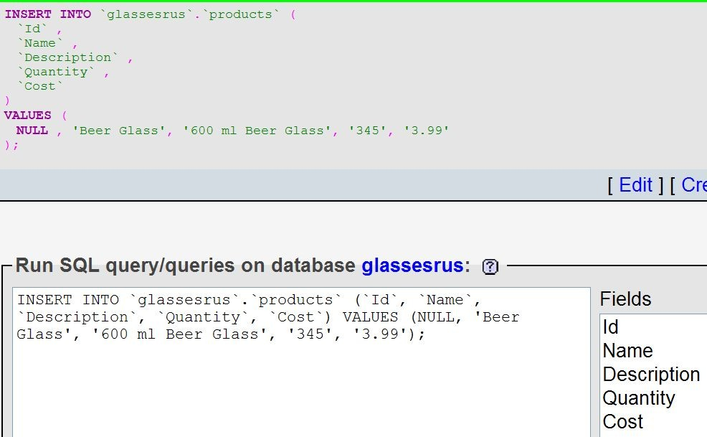
Insert Record: Products

Slide 39
Table: Products (data)

Slide 40
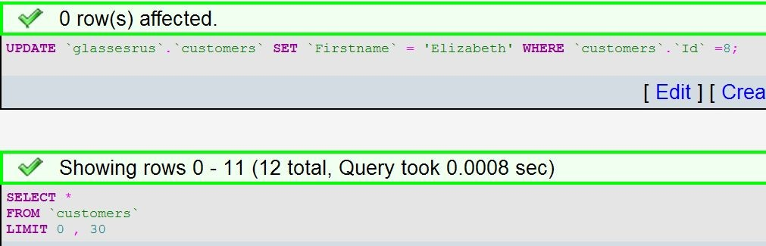
Edit Record

Slide 41
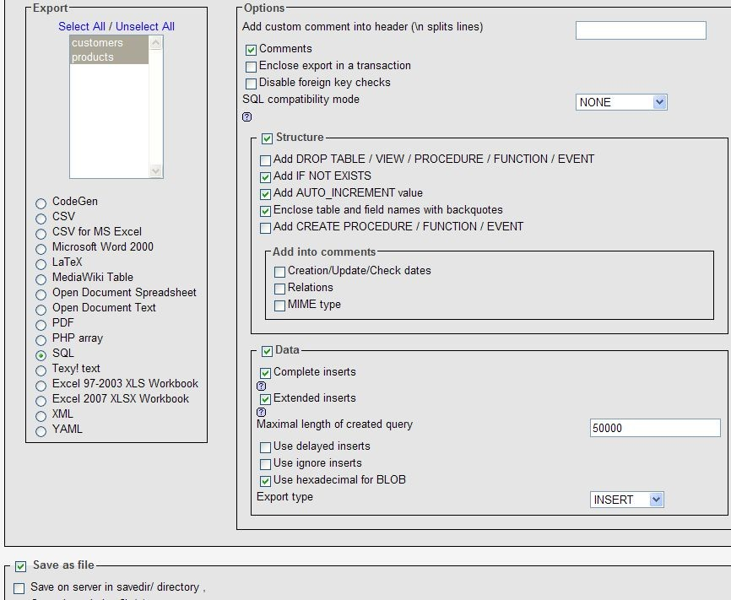

Export

Slide 42
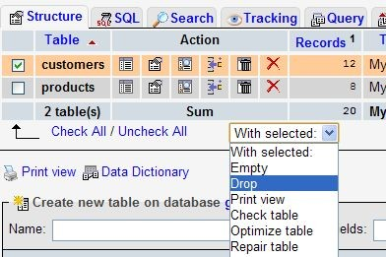
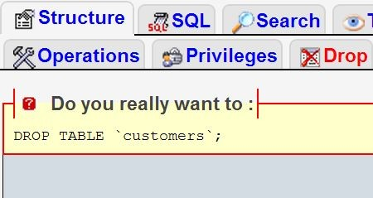
Deleting a Table

Slide 43
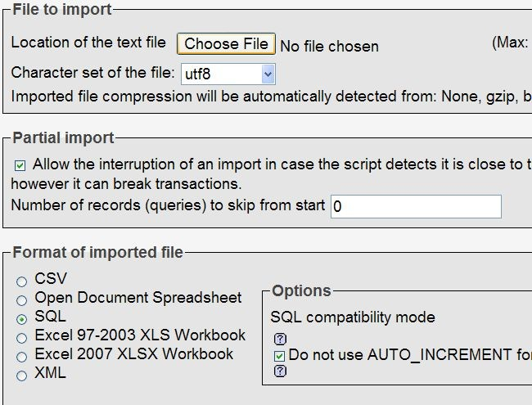
Restoring a database from an SQL file

Slide 44
Database Design

Slide 45
Summary
Concept of databases
Tables and Fields
Field Types
phpMyAdmin Tool for manipulating databases
Creation of a database
How to add and edit records
How to back-up a database
Database Design

Slide 46
MySQL and PHP

Slide 47
Connecting to a MySQL DBMS
In order for our PHP script to access a database we need to form a connection from the script to the database management system.
resourceId = mysql_connect(server, username, password);
Server is the DBMS server
username is your username
password is your password

Slide 48
Connecting to a MySQL DBMS
In order for our PHP script to access a database we need to form a connection from the script to the database management system.
resourceId = mysql_connect(server, username, password);
The function returns a resource-identifier type.
a PHP script can connect to a DBMS anywhere in the world, so long as it is connected to the internet.
we can also connect to multiple DBMS at the same time.

Slide 49
Selecting a database
Once connected to a DBMS, we can select a database.
mysql_select_db(databasename, resourceId);
the resourceId is the one returned by mysql_connect()
the function returns true if the selection succeeded; false, otherwise.

Slide 50

Example: Connect to a DBMS and access database
<?php
$dbLocalhost = mysql_connect("localhost", "root", "") or die("Could not connect: " . mysql_error());
mysql_select_db("glassesrus", $dbLocalhost)
or die("Could not find database: " . mysql_error()); echo "<h1>Connected To Database</h1>";
?>
die() stops execution of script if the database connection attempt failed.
mysql_error() returns an error message from the previous MYSQL operation.

Slide 51
Reading from a database
We can now send an SQL query to the database to retrieve some data records.
resourceRecords = mysql_query(query, resourceId);
the resourceId is the one returned by mysql_connect()
the function returns a resource identifier to the returned data.

Slide 52

Example: Connect to a DBMS, access database, send query
<?php
$dbLocalhost = mysql_connect("localhost", "root", "") or die("Could not connect: " . mysql_error());
mysql_select_db("glassesrus", $dbLocalhost)
or die("Could not find database: " . mysql_error());
$dbRecords = mysql_query("SELECT * FROM customers", $dbLocalhost) or die("Problem reading table: " . mysql_error());
echo "<h1>Connected To Database</h1>";
?>
the function will return a resource pointer (not the actual data) to all the records that match the query.
If all goes well, this script will output nothing on screen.

Slide 53
Extract contents of one record
We can now extract the actual data from the resource pointer returned by mysql_query().
fieldData= mysql_result(resourceRecords, row, field);
the resourceRecords is the one returned by mysql_query()
field – database field to return
the function returns the data stored in the field.

Slide 54

Example: Connect to a DBMS, access database, send query
<?php
$dbLocalhost = mysql_connect("localhost", "root", "") or die("Could not connect: " . mysql_error());
mysql_select_db("glassesrus", $dbLocalhost)
or die("Could not find database: " . mysql_error());
$dbRecords = mysql_query("SELECT * FROM customers", $dbLocalhost) or die("Problem reading table: " . mysql_error());
$strSurname = mysql_result($dbRecords, 0, "Surname"); echo "<p>$strSurname</p>";
?>
the function will return a resource pointer (not the actual data) to all the records that match the query.
If all goes well, this script will output a surname on screen.

Slide 55
SQL statement
SELECT * FROM customers
Go and obtain from the database
every field
FROM the
customers table

Slide 56
Separating the database connection
It is worth separating the database connectivity from our scripts and placing it in a separate file.
It provides a convenient means of moving your scripts from one database platform to another.

Slide 57

Example: Separating the database connection
<?php
// File: database2.php
$strLocation = "Home";
//$strLocation = "Work";
if ($strLocation == "Home") {
$dbLocalhost = mysql_connect("localhost", "root", "") or die("Could not connect: " . mysql_error());
mysql_select_db("glassesrus", $dbLocalhost)
or die("Could not find database: " . mysql_error());
} else {
$dbLocalhost = mysql_connect("localhost", "username", "password") or die("Could not connect: " . mysql_error());
mysql_select_db("anotherdatabase", $dbLocalhost) or die("Could not find database: " . mysql_error());
}
?>
$strLocation could be easily switched between ‘Home’ or ‘Work’

Slide 58

Viewing a whole record
To view the whole record returned from mysql_query(), we need another function...
array = mysql_fetch_row(resourceRecords)
resourceRecords – resource identifier returned from mysql_query().
it returns an array containing the database record.

Slide 59
Example: Displaying all customer records
<?php
require_once("database2.php");
$dbRecords = mysql_query("SELECT * FROM customers", $dbLocalhost) or die("Problem reading table: " . mysql_error());
while ($arrRecord = mysql_fetch_row($dbRecords)) { echo "<p>" . $arrRecord[0] . " ";
echo echo echo
$arrRecord[1] . " ";
$arrRecord[2] . " ";
$arrRecord[3] . "</p>";
}
?>
The function returns false when the last record is returned; thus, stopping the loop.
Note, however, that the fields are referred to by using numbers – not very easy to read and mistakes can be introduced.

Slide 60
Limiting the records returned
SELECT Surname FROM customers
Retrieves only the Surname field from the table customers

Slide 61
Limiting the records returned
SELECT * FROM customers LIMIT 3,4
Select a certain number of records form a table
3 is the starting row
4 is the number of records to be selected after the starting row

Slide 62
Searching for matching records
SELECT * FROM customers WHERE Title=‘Mr’
The WHERE attribute specifies what to search for within the database records.
in this example, only records which have a title of ‘Mr’ will be returned.

Slide 63
Searching for matching records
SELECT * FROM customers WHERE Title=‘Mr’ OR Title=‘Mrs’
The WHERE attribute specifies what to search for within the database records.
in this example, only records which have a title of ‘Mr’ or ‘Mrs’ will be returned.
we can also use AND and OR to formulate more sophisticated conditions.
•

Slide 64
Searching for matching records
SELECT * FROM customers WHERE Title=‘Mr’ AND Surname=‘Smith’ OR Title=‘Mrs’
The WHERE attribute specifies what to search for within the database records.
in this example, only records which have a surname of ‘Smith and title of ‘Mr’ or the title of ‘Mrs’ will be returned.
we can also use AND and OR to formulate more sophisticated conditions.
•

Slide 65
Sorting records
The ORDER BY attribute can be used to sort the order in which records are obtained.
SELECT * FROM cutomers ORDER BY Surname DESC
the ORDER BY attribute is followed by the data field on which to sort the record
DESC or ASC – from high to low, or from low to high
Example15-12.php

Slide 66
Accessing Multiple Tables
<?php
// File: example15-13.php
require_once("database2.php");
$dbRecords = mysql_query("SELECT * FROM customers WHERE Title = 'Mrs'", $dbLocalhost) or die("Problem reading table: " . mysql_error());
echo "<p>Customers:</p>";
while ($arrRecords = mysql_fetch_array($dbRecords)) { echo "<p>" . $arrRecords["Id"] . " ";
echo $arrRecords["Title"] . " "; echo $arrRecords["Surname"] . " ";
echo $arrRecords["Firstname"] . "</p>";
}
//...continued...
Example15-13.php

Slide 67
Accessing Multiple Tables
//continuation...
$dbRecords = mysql_query("SELECT * FROM products WHERE Name = 'Wine Glass'",
$dbLocalhost)
or die("Problem reading table: " . mysql_error());
echo "<p>Products:</p>";
while ($arrRecords = mysql_fetch_array($dbRecords)) { echo "<p>" . $arrRecords["Id"] . " ";
echo $arrRecords["Name"] . " "; echo $arrRecords["Description"] . " "; echo $arrRecords["Quantity"] . " "; echo $arrRecords["Cost"] . "</p>";
}
?>
Example15-13.php

Slide 68

Using records to read another table
Read a customer record, and then show the products purchased by that customer.
Tables
Customers
Products
Purchases
PurchaseProducts
Example15-14.php

Slide 69
BIRD’S EYEVIEW
Using records to read another table
...
$strSurname = "Jones";
$dbCustRecords = mysql_query("SELECT * FROM customers WHERE Surname = '$strSurname' ",...) while ($arrCustRecords = mysql_fetch_array($dbCustRecords)) { //#1
$intId = $arrCustRecords["Id"];
//display customer’s details
$dbPurRecords = mysql_query("SELECT * FROM purchases WHERE customers_Id = '$intId'", ...)
while ($arrPurRecords = mysql_fetch_array($dbPurRecords)) {//#2
$intPurId = $arrPurRecords["Id"];
//display purchase date
$dbProRecords=mysql_query("SELECT * FROM purchaseProducts WHERE purchases_Id='$intPurId' ",..)
while ($arrProRecords = mysql_fetch_array($dbProRecords)) { //#3
$intProductId = $arrProRecords["products_Id"];
//display Quantity
$dbProductRecords = mysql_query("SELECT * FROM products WHERE Id = '$intProductId'",..)
$arrProductRecord = mysql_fetch_array($dbProductRecords);
//display product details
} #3
} #2
} //#1
Example15-14.php

Slide 70
Complete version
Using records to read another table
<?php require_once("database2.php");
$strSurname = "Jones";
$dbCustRecords = mysql_query("SELECT * FROM customers WHERE Surname = '$strSurname' ", $dbLocalhost)
or die("Problem reading table: " . mysql_error());
while ($arrCustRecords = mysql_fetch_array($dbCustRecords)) {
$intId = $arrCustRecords["Id"]; echo "<p>Customer: ";
echo $arrCustRecords["Title"] . " "; echo $arrCustRecords["Surname"] . " ";
echo $arrCustRecords["Firstname"] . "</p>";
$dbPurRecords = mysql_query("SELECT * FROM purchases WHERE customers_Id = '$intId'",
$dbLocalhost)
or die("Problem reading table: " . mysql_error());
Example15-14.php

Slide 71

Complete version
Using records to read another table
while ($arrPurRecords = mysql_fetch_array($dbPurRecords)) {
$intPurId = $arrPurRecords["Id"]; echo "<p>Purchased On: ";
echo $arrPurRecords["Day"] . "/"; echo $arrPurRecords["Month"] . "/"; echo $arrPurRecords["Year"] . "</p>";
$dbProRecords= mysql_query("SELECT * FROM purchaseProducts WHERE purchases_Id='$intPurId' ",
$dbLocalhost)
or die("Problem reading table: " . mysql_error());
while ($arrProRecords = mysql_fetch_array($dbProRecords)) {
$intProductId = $arrProRecords["products_Id"]; echo "<p>" . $arrProRecords["Quantity"] . " ";
$dbProductRecords = mysql_query("SELECT * FROM products WHERE Id = '$intProductId'",
$dbLocalhost)
or die("Problem reading table: " . mysql_error());
$arrProductRecord = mysql_fetch_array($dbProductRecords);
echo $arrProductRecord["Name"] . " (" . $arrProductRecord["Description"] . ") at &#163;"; echo $arrProRecords["Cost"] . " each.</p>";
}
}
Example15-14.php
}
Example15-14.php

Slide 72
Inserting records
How to create new database records and insert them into a table?
INSERT INTO table (field1, field2,...) VALUES (‘value1’, ‘value2’,...)
Alternatively, we have a simplified syntax:
INSERT INTO table VALUES (‘value1’, ‘value2’,...)
$dbProdRecords = mysql_query("INSERT INTO products VALUES ( ' ', 'Beer Mug', '600 ml Beer Mug', '100', '5.99')",
$dbLocalhost)
Example15-15.php

Slide 73

Inserting records
<?php
// File: example15-15.php
require_once("database2.php");
$dbProdRecords = mysql_query("INSERT INTO products VALUES ('', 'Beer Mug', '600 ml Beer Mug', '100', '5.99')", $dbLocalhost)
or die("Problem writing to table: " . mysql_error());
$dbProdRecords = mysql_query("SELECT * FROM products", $dbLocalhost) or die("Problem reading table: " . mysql_error());
while ($arrProdRecords = mysql_fetch_array($dbProdRecords)) { echo "<p>" . $arrProdRecords["Id"] . " ";
echo $arrProdRecords["Name"] . " "; echo $arrProdRecords["Description"] . " "; echo $arrProdRecords["Quantity"] . " "; echo $arrProdRecords["Cost"] . "</p>";
}
?>
Example15-14.php
Example15-15.php

Slide 74
Deleting records
How to delete database records from tables?
DELETE FROM table WHERE field=‘value’
e.g.
$dbCustRecords = mysql_query("DELETE FROM customers WHERE Id='3'", $dbLocalhost)
Note: If you have a relational database, you should tidy-up the other tables, based on their connection with the record you’ve deleted.
Example15-16.php

Slide 75
Deleting records
How to delete database records from tables?
DELETE FROM table
This will delete all records from a table!
Note: back-up your database first!
Example15-17.php

Slide 76
Amending records
How to modify the contents of an existing database record?
UPDATE table SET field=‘value1’, field=‘value2’...WHERE field=‘value’
requires you to specify the table, the list of fields with their updated values, and a condition for selection (WHERE).
Example15-18.php

Slide 77
Amending records
<?php
// File: example15-18.php
require_once("database2.php");
$dbCustRecords = mysql_query("UPDATE products SET Description='250 ml Tall Glass' WHERE Id='6'", $dbLocalhost)
or die("Problem updating table: " . mysql_error());
$dbProdRecords = mysql_query("SELECT * FROM products", $dbLocalhost) or die("Problem reading table: " . mysql_error());
while ($arrProdRecords = mysql_fetch_array($dbProdRecords)) { echo "<p>" . $arrProdRecords["Id"] . " ";
echo $arrProdRecords["Name"] . " "; echo $arrProdRecords["Description"] . " "; echo $arrProdRecords["Quantity"] . " "; echo $arrProdRecords["Cost"] . "</p>";
}
?>
Example15-14.php
Example15-18.php

Slide 78
Amending records
How to modify the contents of an existing database record?
UPDATE table SET field=‘value1’, field=‘value2’...WHERE field=‘value’
Another Example:
$dbCustRecords = mysql_query("UPDATE products SET Name='Beer and Lager Glass' WHERE Name='Beer Glass'", $dbLocalhost)
A number of records will be updated in this example.
Example15-19.php

Slide 79
Counting the number of records
How to count the number of records after running a query?
$dbProdRecords = mysql_query("SELECT * FROM products",
$dbLocalhost)
or die("Problem reading table: " . mysql_error());
$intProductCount = mysql_num_rows($dbProdRecords);
you can also use the same function to determine if a record exists.
Example15-20.php Example15-21.php

Slide 80
Select a substring
How to count the number of records after running a query?
SELECT * FROM products WHERE substring(Name,1,4)=‘Wine’
This will return all records from the products table where the first four characters in the name field equals ‘Wine’
Example15-22.php

Slide 81
End of Lecture

